Slide 1


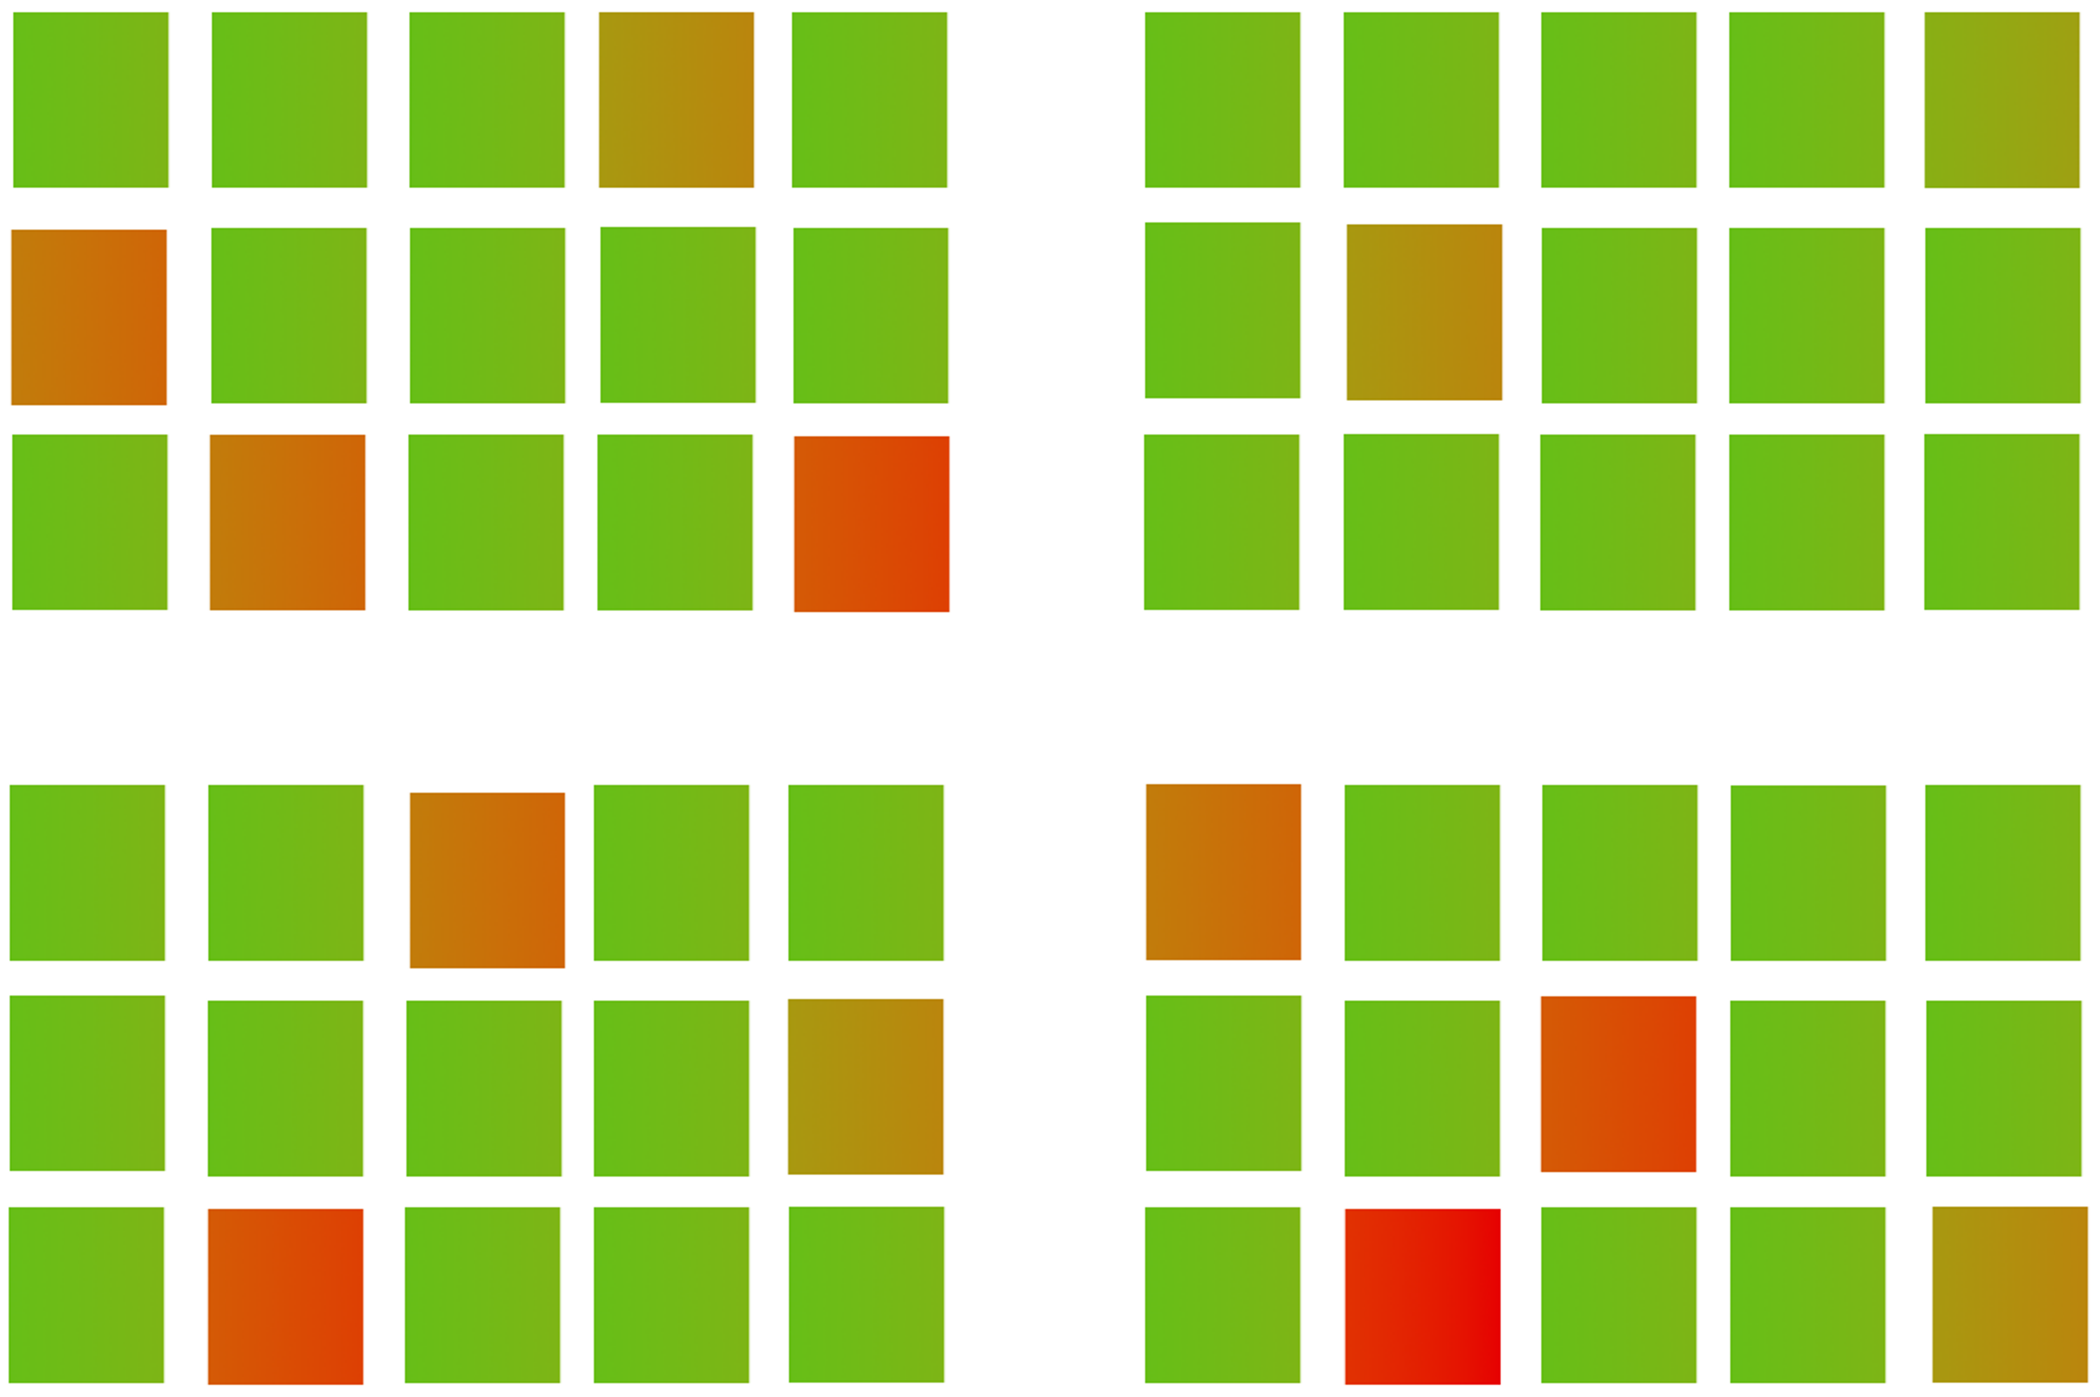


Selective scrubbing based on algorithmic randomness
Rahul Vishwakarma○, Bing Liu✢, Peter Gatsby○, Jinha Hwang○
✢Dell Technologies, ○California State University Long Beach
Introduction
Contribution
Frequently scrubbing the entire storage array during high incoming IO on a system can degrade the performance of the individual disks
Decide “which disk to scrub” and “when to scrub”
Method
Conformal Prediction for quantifying the disk health
Optimal Scrubbing
Select only specific disks which really need scrubbing based on their health
Performance
Automated scheduling of disk scrubbing based on n-step ahead system load prediction using probabilistic weighted fuzzy time series
Figure 3. Proposed framework for selective disk scrubbing
Solution
Input dataset (disk statistics)
Advantages
Disks marked for scrubbing
Not Scrubbed
Conformal Prediction
Disk Health | Scrub Frequency | Heath
Best | LOW (CYCLE – A) | 1 – 0.7
Medium | MEDIUM (CYCLE - B) | 0.7 – 0.3
Poor | HIGH (CYCLE – C) | 0.3 – 0
Enhanced storage reliability
More frequent scrubbing on poor healthy drives
It helps detect and correct sector errors in advance
Improved performance
Healthy drives are scrubbed less often freeing up resources for user workloads
Figure 1. Selective scrubbing of least healthy disks
Disk Heath score
Method
Healthy
Dying/Imminent failure
Healthy
Dying/Imminent failure
Least healthy disks
Figure 6. Disks are segregated based on their health and assigned scrub frequency.
Least healthy disk
Figure 4. Disk health classification
Quantification of the degree of health
Disk Serial | Health Rank | Status
Z296Z3KN | 0.934426 | HEALTHY
Z296Z3A6 | 0.819672 | HEALTHY
Z296Z5MQ | 0.754098 | HEALTHY
Z29987ZE | 0.474212 | HEALTHY
Z29609UI | 0.321424 | HEALTHY
Z29IUW4 | 0.287129 | HEALTHY
Disk Serial | Health Score | Status | Scrub Frequency
9330KBD2 | 0.934426 | MEDIUM | CYCLE - B
9330EHZU | 0.819672 | BEST | CYCLE - A
9330KB5X | 0.606557 | MEDIUM | CYCLE - B
9330K3D5 | 0.491803 | MEDIUM | CYCLE - B
09330K6PW | 0.360656 | POOR | CYCLE - C
. . . | . . . | . . . | . . .
ZSE98JUKS | 0.023149 | POOR | CYCLE - C
Figure 2. Drive health quantification based on conformal prediction
Rank the health scores based on confidence
Create a set of relatively least healthy disks for scrubbing
Map the selected disks with scrub frequency cycle
Acknowledgement
Figure 5. We quantify the degree of health of the disks and rank them as per the confidence of the prediction.
The project has been supported by Dell Technologies, Israel (Yosef Shatsky) and Dell EMC China (Bing Liu).
Figure 7. Implementation of selective scrubbing based on algorithmic randomness.

